Slide 1


Economic Analysis: U.S. States since the 2008 Recession

Slide 2
1. Determine which states were the most/least affected by the 2008 Recession and which recovered the best/worst 2. Test factors that we think correlate with the most/least affected states.
Objective:
Method:
Two indicators:
1. Change in State GDP by year
2. Change in Unemployment rate by year
Datasets were .csv files from data.gov & census.gov

Slide 3
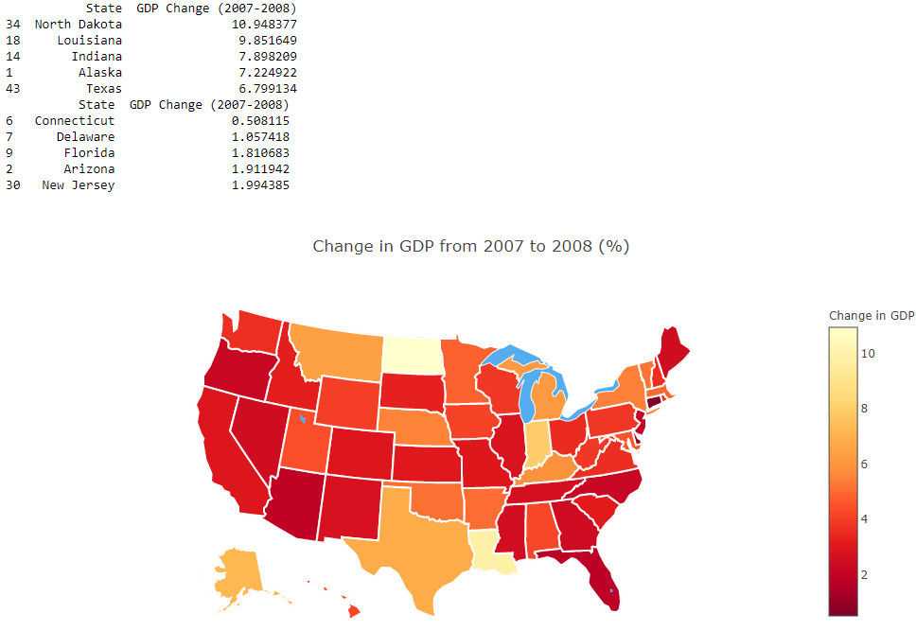
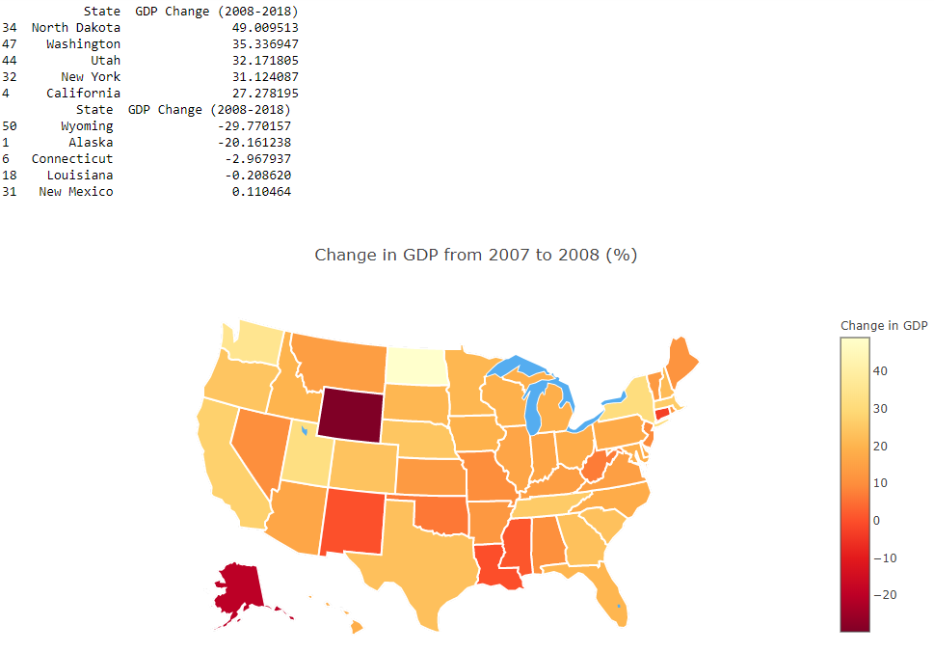
State GDP Changes

Slide 4
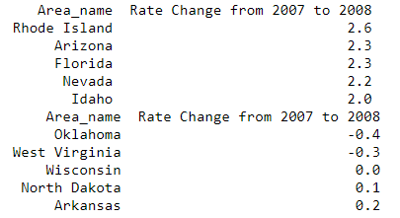
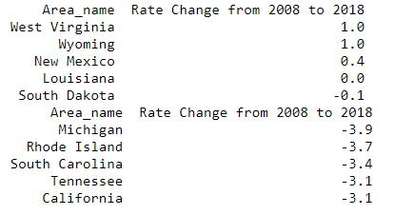
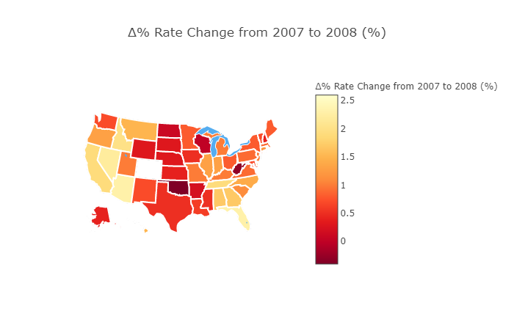
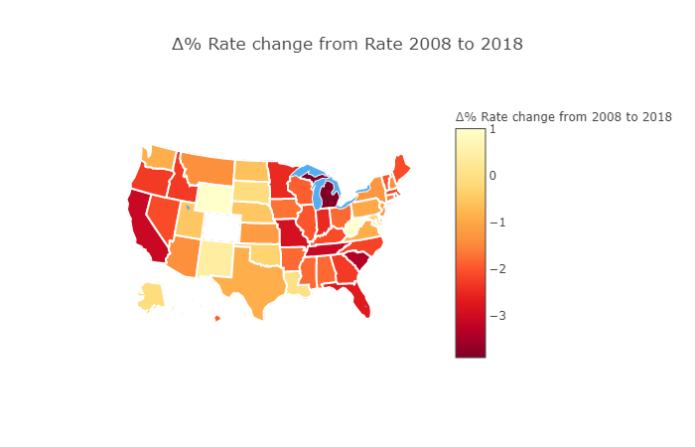
Unemployment Rate Changes
Notes:
Referring to the previous slide of state GDP we noticed a positive correlation between California’s state GDP change from 2008 to 2018 and Unemployment rate change from 2008 to 2018 as being in the top 5. I also noticed that Louisiana had very little change from 2008 to 2018 in state GDP and in unemployment change from 2008 to 2018. Another Inference that can be observed from the State GDP and the Unemployment rate changes is how Wyoming was one of the worst states that recovered from the 2008 financial crisis with a GDP decreased by 29.7% and unemployment increased by 1% since 2008 to 2018.

Slide 5
Population

Slide 6
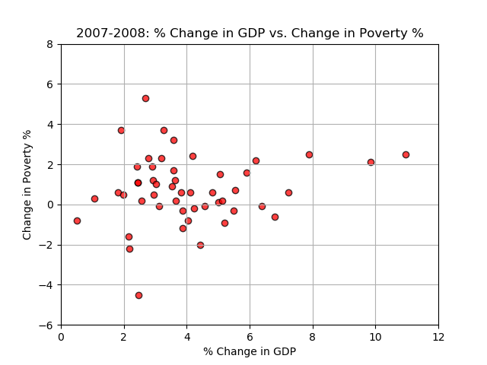
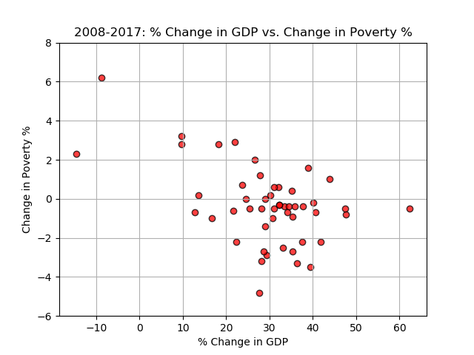
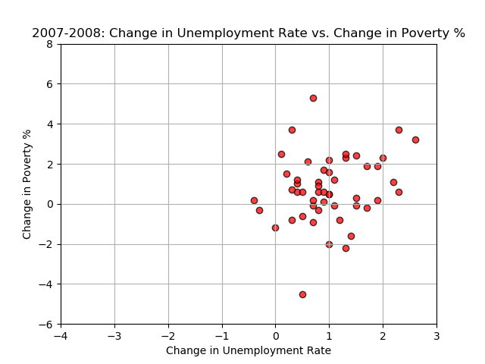
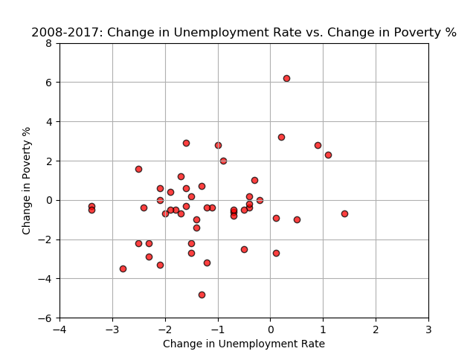
Poverty Rates vs. Changes in GDP and Unemployment Rates

